Slide 1
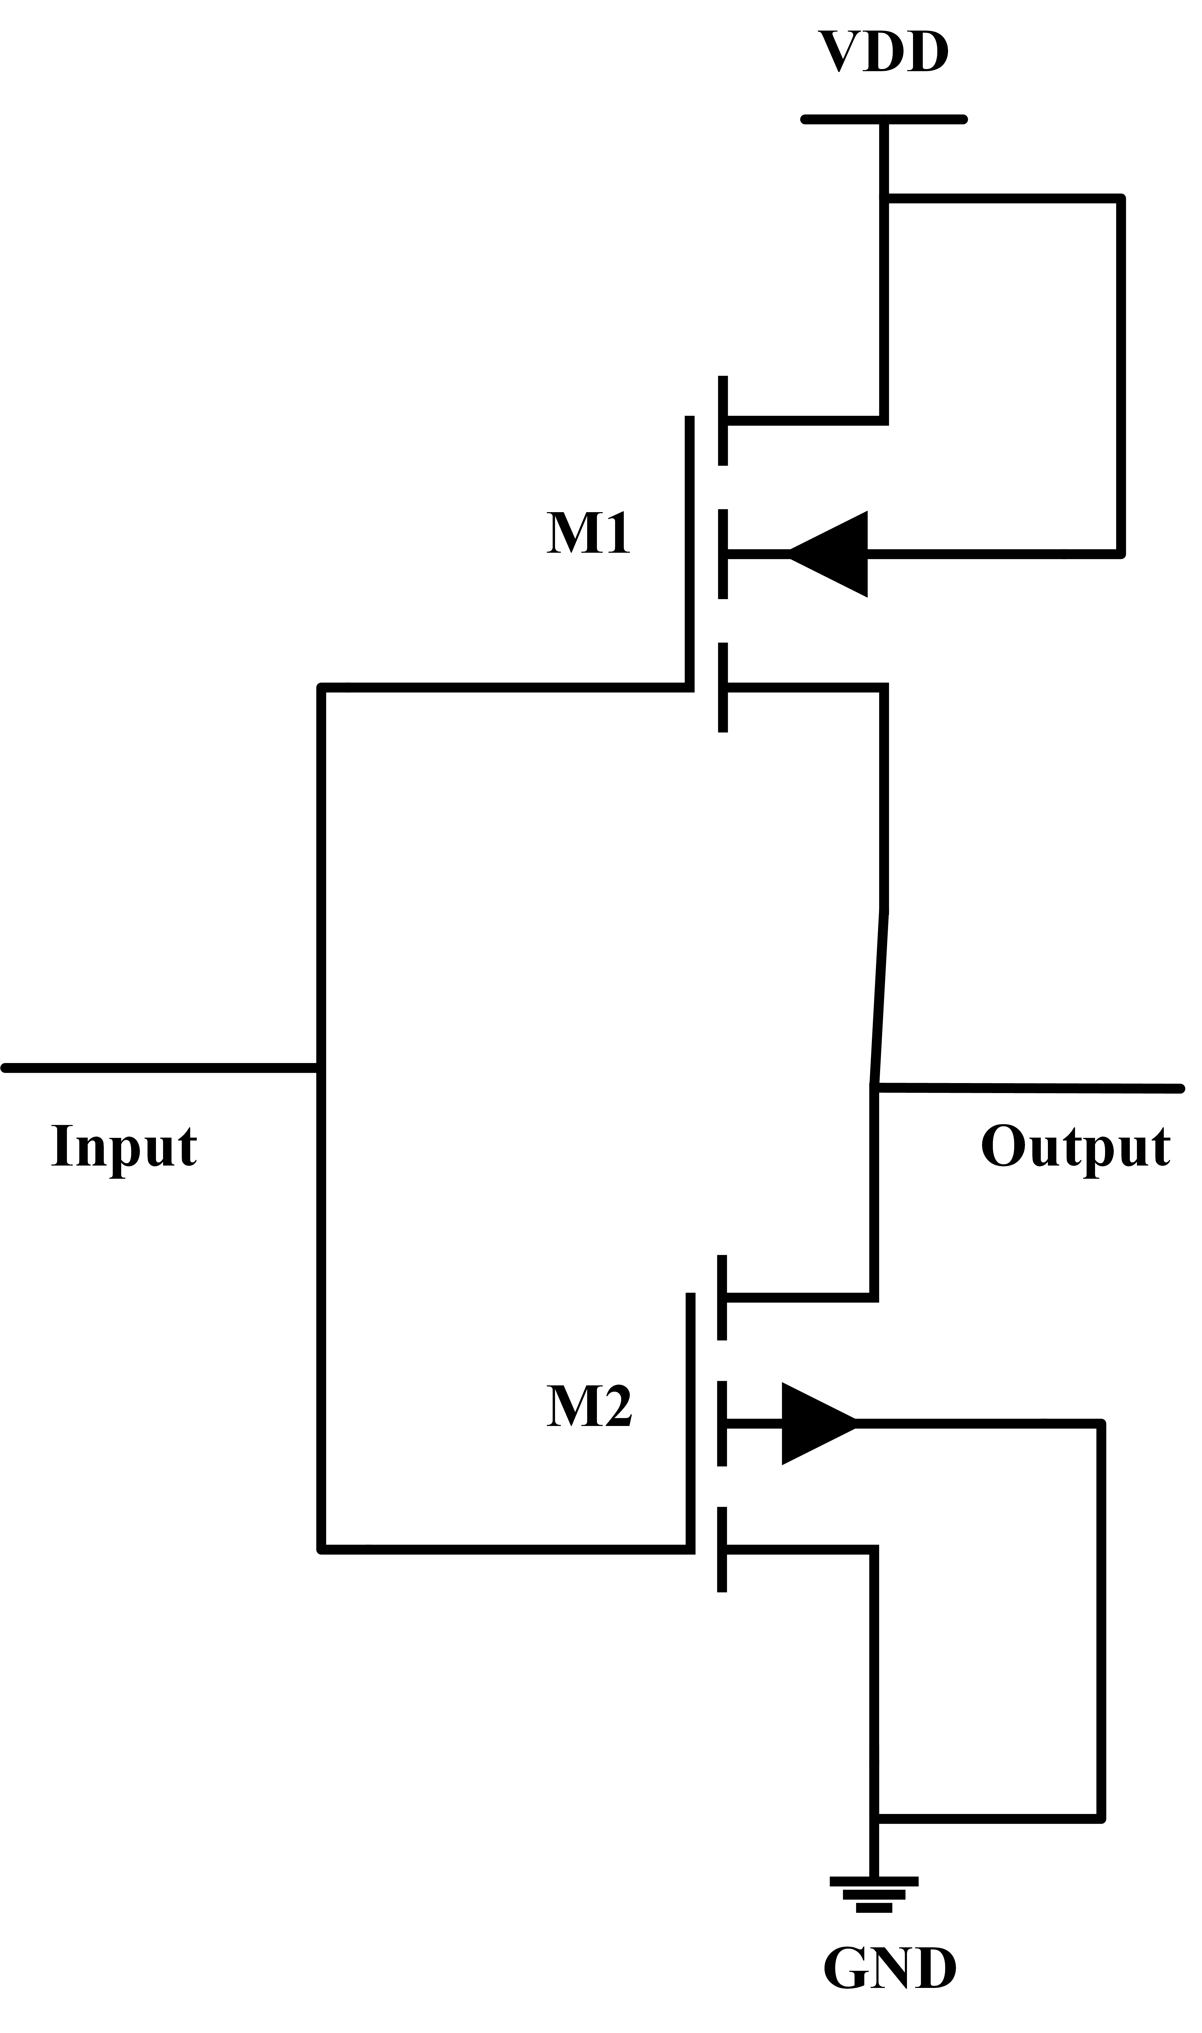
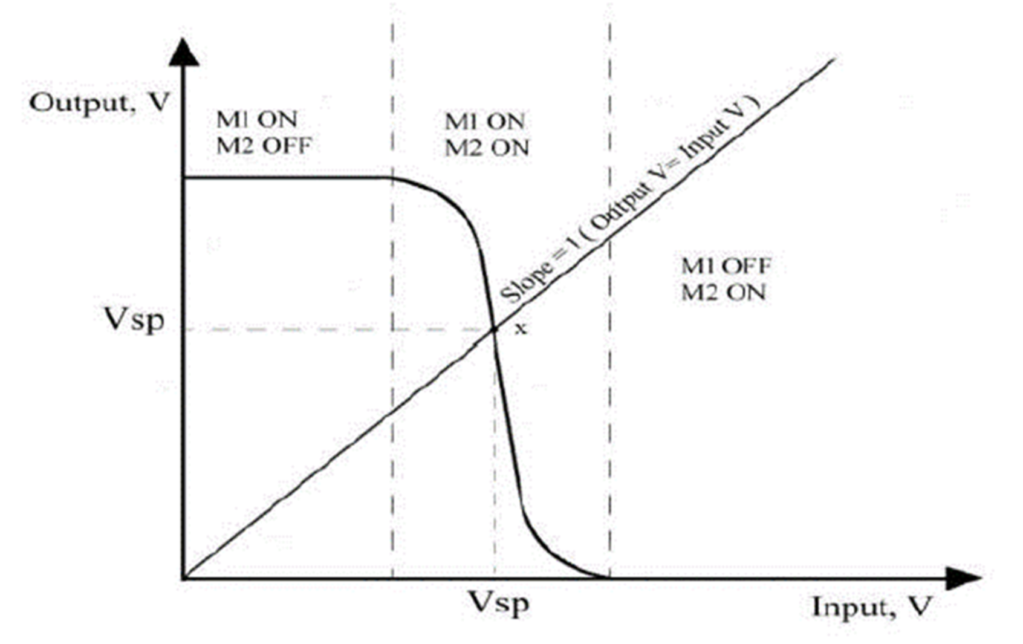
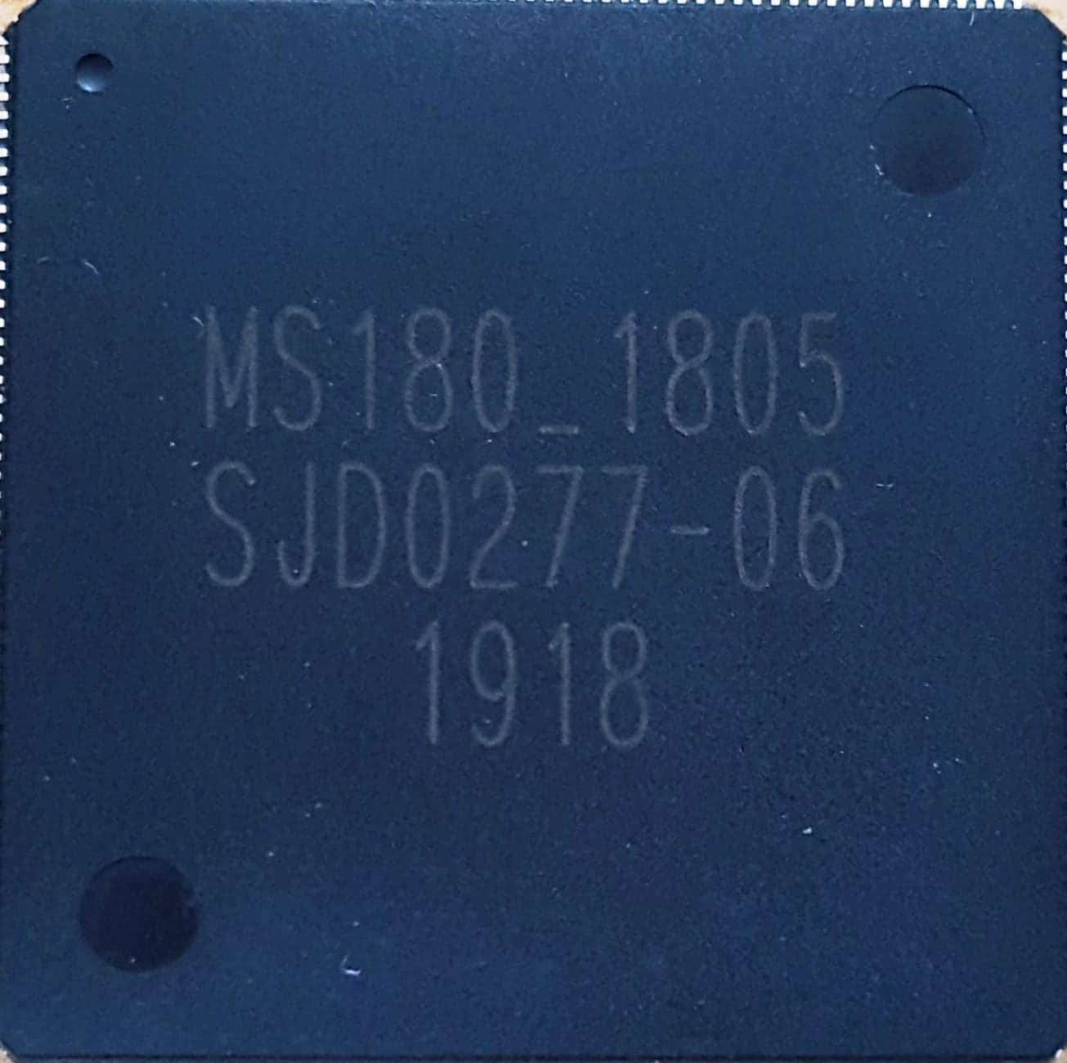
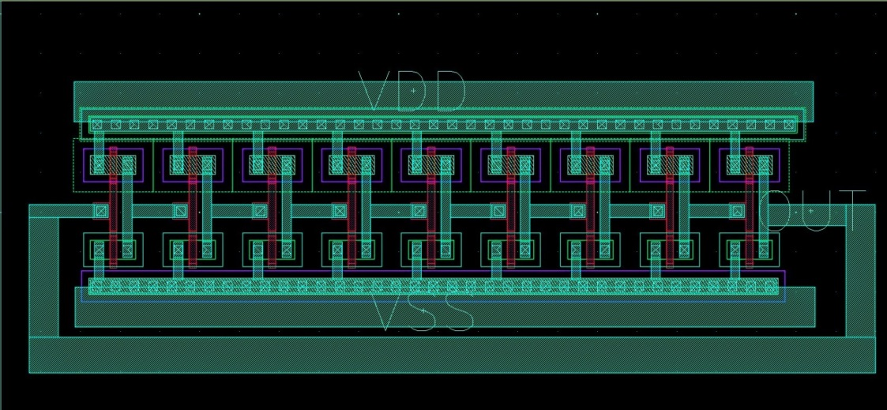
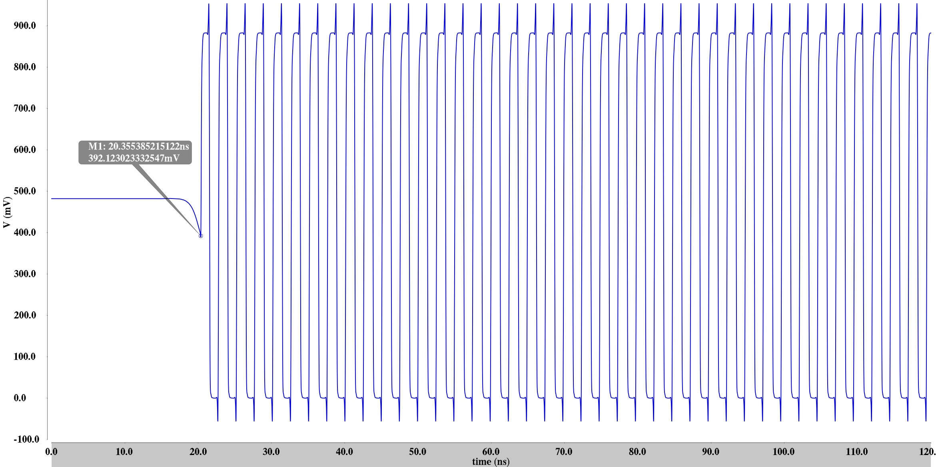
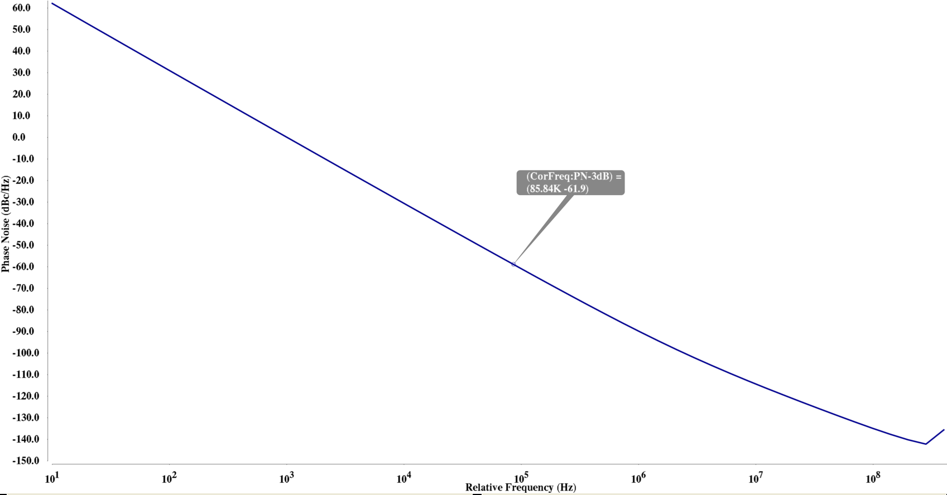
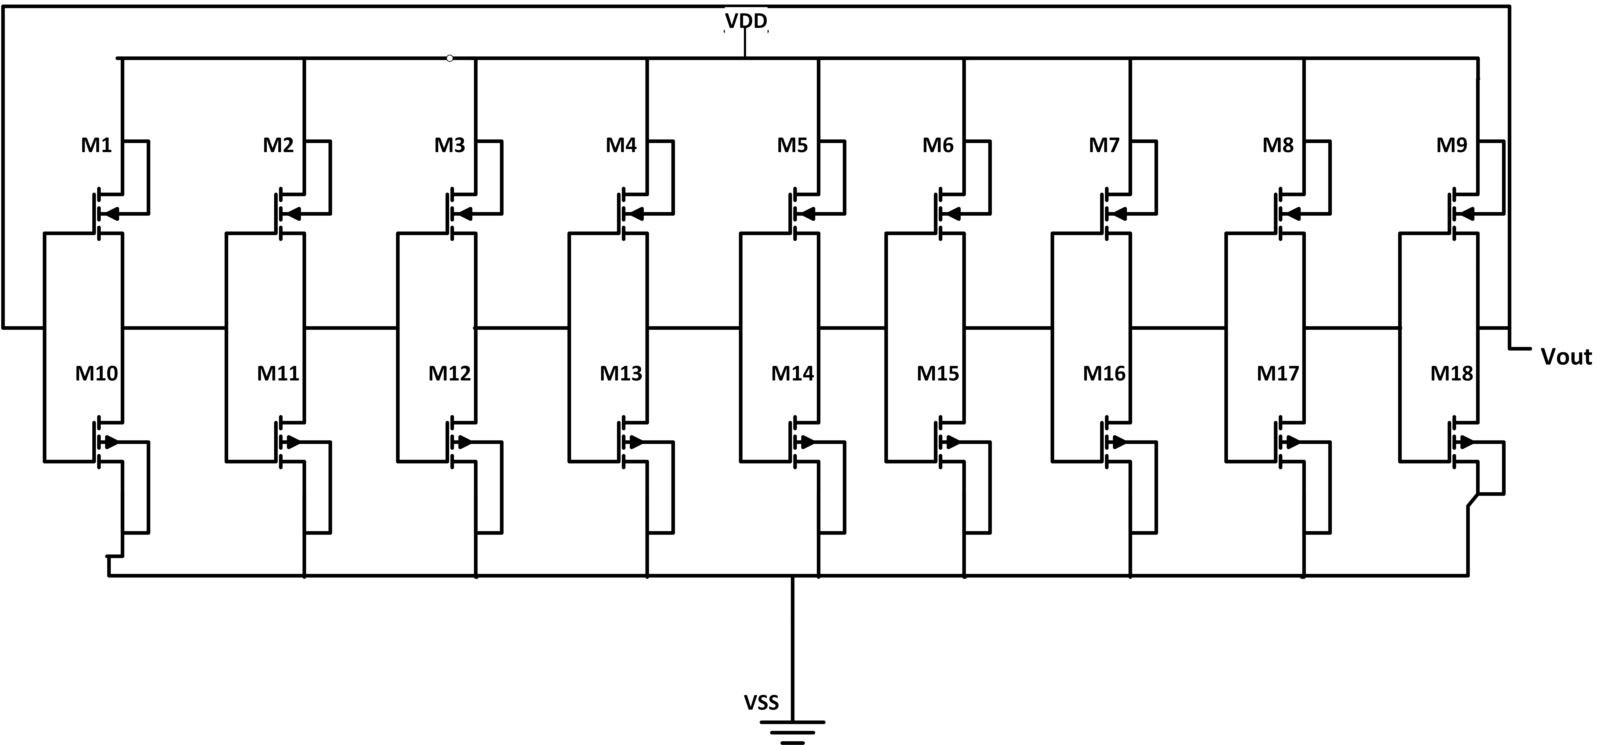
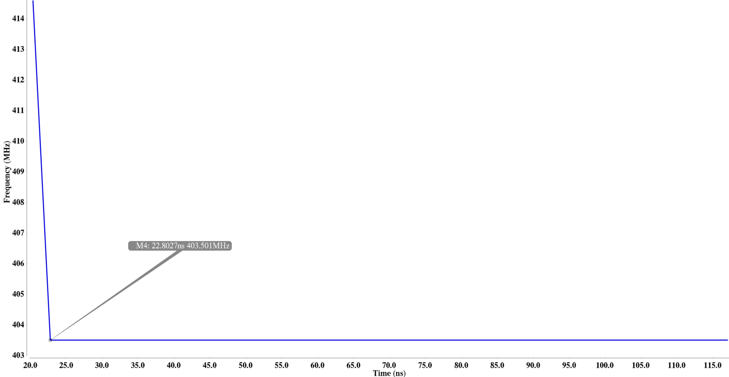
403.5-MHz CMOS Ring Oscillator for the Implementation in Biomedical Implantable Device in 180-nm CMOS
Arifa Ferdousi and GoangSeog Choi
Department Information and Communication Engineering, Chosun University
E-mail : gschoigs@chosun.ac.kr
1. Introduction
For the design flexibility, such as replacing the heavy and power hungry components like inductors and resistors, ring oscillator is always favored by the circuit designers. Since the design of the ring oscillator is fully transistor based.
This work focuses on , generating continuous 403.5MHz carrier frequency with minimum starting delay and low power consumption for the implementation in wireless transceiver design in biomedical implanted devices.
The design uses 9-stage delay inverters with feedback to generate the continuous full cycle carrier frequency. W/L ratio of the transistors are optimized. No external biasing voltage is applied to optimize the delay time.
2. Delay Inverter and transfer Function
Fig. 3. Fabricated IC and Circuit layout
Fig. 1. Single inverter and Response graph of transfer function
A ring oscillator is usually made with delay stages and odd number of inverter stages is used to make an oscillator. According to Barkahausen criteria, all stages should add (or reduce) a 180⁰/N phase to the signal. Where the other 180⁰ is provided by the sign of inverter and N is an odd number of stages. Frequency of the oscillation is determined by
3. Designed Ring Oscillator
(a)
Fig. 2. Proposed ring oscillator with 9-stage delay Inverter
(b)
The frequency of oscillation is calculated by $f_{0}=\frac{1}{2Nt_{d}}$, where N is the number of stages and t_{d} is the propagation delay or gate delay. The estimated time delay for the output voltage of an NMOS and CMOS inverter drives the capacitance of the next stage to cross the trip point in response to an input step.
4. Results and Discussion
The design was implemented in the SK-Hynix 180-nm CMOS
process. The measured power consumption was 9.07W for the VDD= 0.89 V. Lowest phase noise is -142 dBc/Hz. Starting delay is 22ns for the generated stable frequency 403.5 MHz.
(c)
Fig.4. (a) Starting delay of the oscillator, (b) Average phase noise (c) Generated stable 403.5MHz continuous frequency.
5. Conclusion
This nine stage ring oscillator was designed using 180-nm technology for biomedical implant devices, which shows a better performance in comparison with a conventional power and space hungry RC or LC oscillator. The accuracy of the frequency generation without extra biasing achieved using this simple method is highly significant.
Acknowledgement The chip fabrication and EDA tool were supported by the IC Design Education Center(IDEC), Korea

